Slide 1
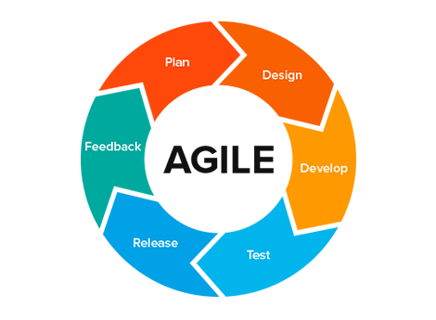
What it means to be
Josiah Roske

Slide 2
The Scrum Team
The scrum team consists of a product owner, scrum master and development team, which can include member such as testers and developers. All of these roles play crucial parts in the execution and delivery of a product.
The idea of a scrum team is to limit the size of the team in order to remain nimble enough to take on the any changes, while bolstering team members confidence in their work.

Slide 3
The Product owner
“The product owner is accountable for maximizing the value of the product resulting from the work of the scrum team. (scrumguides.org)”
Visionary for the client/stakeholders
Creates the goals of the product
Develops user stories and item backlog

Slide 4
The Scrum Master
The Scrum Master is a servant leader, they help their team by assisting them in whatever way is needed.
“To be successful, the Scrum Master must wear different hats that depend on the situation or challenge the team is facing(Scrum.org).”
Run and keep scrum meetings on track
Coach the team on agile principles
Helps remove impediment of their team members
Acts as a middle man between the developers and stakeholders
Assists Product Owner in stakeholder meetings

Slide 5
The Development Team(Testers and Developers)
The Development team is the core of the scrum team. They are the ones who deliver the product.
“It is important to remember that a Developer is not necessarily a software developer. They can focus on any type of product work whether software or not and any aspect of helping to design, build, test or ship the product(Scrum.org).”
Help develop sprint plan
Self governing members
Collaboration amongst other team members
Develop quality products
Able to adapt to changes in projects

Slide 6
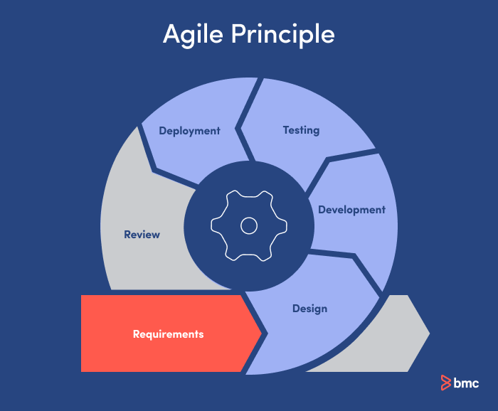
The Software Development Life Cycle in Agile
Planning (Sprints & Backlog)
Execution (Daily stand-up & Development
Review (Sprint review)
Retrospective (Sprint Retrospective)

Slide 7
Planning & Execution
Planning - The product life cycle will begin with an idea, the product owner will work with the stakeholders and invision this idea. The scrum team will then begin planning their sprint, choosing higher priority items from the back log.
Execution - The team will work on developing the items chosen for the sprint, holding daily meetings in the morning to help keep them on track. There will be constant collaboration between developers and tester to ensure quality, working product.

Slide 8
Review & Retrospective
Sprint Review - This portion occurs at the end of the sprint, where the team gets together and discusses the outcome of the sprint. It is meant to gloss over their accomplishments, adjust the backlog if needed and show the stakeholders the progress.
Retrospective - This is similar to the review portion, it is the final stage of the sprint, but its main focus is to take what was learned during the current sprint and use those experiences to help increase productivity in future sprints.

Slide 9
Waterfall Method
Compared to agile, the waterfall method is a linear approach to a projects development. During the SNHU travel site development, there were changes that occurred in the development process. With a waterfall method there would have been a lack of adaptability to those changes, which would have caused delays in the delivery of the product

Slide 10
Agile or WaterFall
When deciding what approach to choose, there are some key factors to consider
Do you expect changes to occur mid project or not?
Does the project require collaboration?
Is there a project deadline?
Do you need to interact with the clients often?

Slide 11
Agile or Waterfall? cont.
When it comes to changes, agile reigns supreme, the iterative aspects allows for adaptation to changes, while in waterfall, they will cause setbacks. Agile also fosters a constant collaborative environment among team members. This approach also helps if there is a deadline to meet. Under agile, teams are able to more efficiently complete tasks and deliver a product. The iterative aspect of agile is also beneficial when clients are active, it delivers working items that they can make changes to if they please, so that there are not a bunch of changes to a final product.

Slide 12
References
Scrum Guide | Scrum Guides. (n.d.). Scrumguides.org.
https://scrumguides.org/scrum-guide.html#the-sprint
Scrum.org. (2024). What is a Scrum Master? Scrum.org.
https://www.scrum.org/resources/what-is-a-scrum-master
What is a Developer in Scrum? (n.d.). Scrum.org.
https://www.scrum.org/resources/what-is-a-scrum-developer
GeeksforGeeks. (2021, October 15). Agile SDLC (Software Development Life Cycle). GeeksforGeeks. https://www.geeksforgeeks.org/software-engineering/agile-sdlc-software-development-life-cycle/

Slide 13
Images
Aguayo Publicidad. (2018). Agile Methodology in UX | Aguayo’s Blog. Aguayo.co. https://aguayo.co/en/blog-aguayo-user-experience/agile-methodology-in-ux/
Raza, M. (2020, August 11). Agile vs Waterfall SDLCs: What’s The Difference? BMC Blogs. https://www.bmc.com/blogs/agile-vs-waterfall/
‌

